Slide 1
Bowling Alley near York University, Toronto
Balaji Sundarrangan

Slide 2
Problem Statement
The young students of York University do not have a place to hang-out nearby their campus
The Nearest bowling alley is about 10 kilometers
Most of the food outlets close by 10 pm
There is no Karaoke bar nearby to listen to foot-tapping music

Slide 3
Data Science for a Solution
Use Python to import Neighborhood data from a Wikipedia site
Identify top most venues that draw crowd
Explore the neighborhood
Use Data Science approach like K-Means for clustering the neighborhood
Analyze the neighborhood to see what kind of activities are already present
Examine the clusters
Provide observations and recommendations

Slide 4
Scrape the data for a dataset
Index | PostalCode | Borough | Neighborhood | Latitude | Longitude
0 | M3A | North York | Parkwoods | 43.753259 | -79.329656
1 | M4A | North York | Victoria Village | 43.725882 | -79.315572
2 | M6A | North York | Lawrence Manor, Lawrence Heights | 43.718518 | -79.464763
3 | M3B | North York | Don Mills | 43.745906 | -79.352188
4 | M4B | East York | Parkview Hill, Woodbine Gardens | 43.706397 | -79.309937
5 | M6B | North York | Glencairn | 43.709577 | -79.445073
13 | M4H | East York | Thorncliffe Park | 43.705369 | -79.349372
14 | M2J | North York | Fairview, Henry Farm, Oriole | 43.778517 | -79.346556
15 | M3J | North York | Northwood Park, York University | 43.767980 | -79.487262
16 | M4J | East York | East Toronto, Broadview North (Old East York) | 43.685347 | -79.338106
17 | M2K | North York | Bayview Village | 43.786947 | -79.385975
18 | M3K | North York | Downsview | 43.737473 | -79.464763
19 | M2L | North York | York Mills, Silver Hills | 43.757490 | -79.374714
20 | M3L | North York | Downsview | 43.739015 | -79.506944
21 | M6L | North York | North Park, Maple Leaf Park, Upwood Park | 43.713756 | -79.490074
22 | M9L | North York | Humber Summit | 43.756303 | -79.565963
23 | M2M | North York | Willowdale, Newtonbrook | 43.789053 | -79.408493
24 | M3M | North York | Downsview | 43.728496 | -79.495697
25 | M5M | North York | Bedford Park, Lawrence Manor East | 43.733283 | -79.419750
Choose York University

Slide 5
Explore the Neighborhoods
Index | Name | Categories | Latitude | Longitude
0 | MUSE Massage Spa | Massage Studio | 43.765686 | -79.489318
1 | Carribean Heat | Caribbean Restaurant | 43.764155 | -79.490227
2 | Bamiyan Kabob | Middle Eastern Restaurant | 43.773769 | -79.492741
3 | Nino D'Aversa | Pizza Place | 43.759913 | -79.488885
4 | Elite Restaurant | Restaurant | 43.767935 | -79.475379
5 | Tim Hortons | Coffee Shop | 43.764289 | -79.488790
6 | Tim Hortons | Coffee Shop | 43.768074 | -79.472489
7 | Walmart Supercentre | Furniture / Home Store | 43.757860 | -79.488981
8 | Decorium | Furniture / Home Store | 43.776867 | -79.474017
9 | Thai Express | Restaurant | 43.773536 | -79.501941
10 | Dollarama | Discount Store | 43.756249 | -79.487950
11 | Starbucks | Coffee Shop | 43.766762 | -79.475957
12 | Aroma Espresso Bar | Coffee Shop | 43.769918 | -79.502217
13 | Subway | Sandwich Place | 43.767815 | -79.469573
14 | Oishi Sushi | Japanese Restaurant | 43.763523 | -79.490136
15 | TD Canada Trust | Bank | 43.762819 | -79.490251
16 | Tim Hortons | Coffee Shop | 43.760737 | -79.499224
17 | Tim Hortons | Coffee Shop | 43.774266 | -79.493165
18 | Tim Hortons | Coffee Shop | 43.772286 | -79.503403
19 | Petro-Canada | Gas Station | 43.760887 | -79.499426
20 | Tim Hortons (TEL Building) | Coffee Shop | 43.773197 | -79.501292

Slide 6
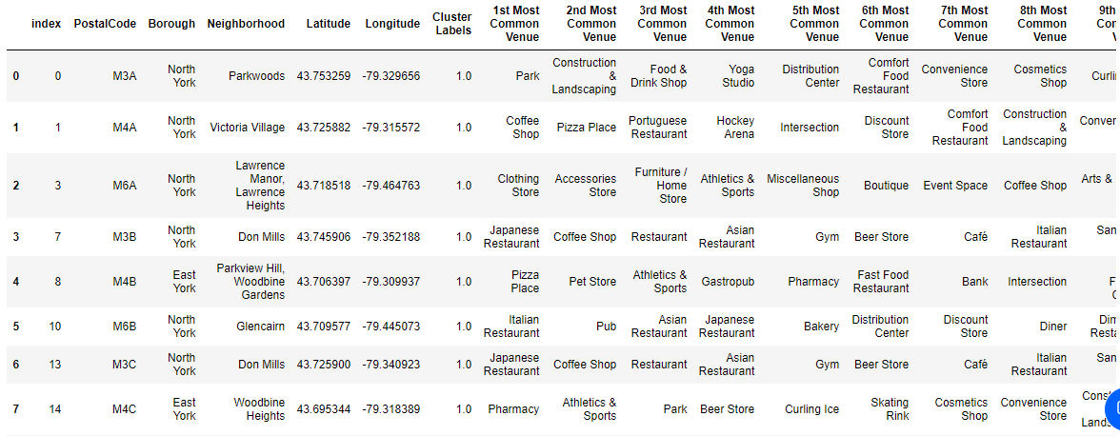
Cluster Neighborhoods
Run K-Means to cluster the neighborhoods into 5 clusters
See below a sample of Cluster 1.0, that has most common venues displayed

Slide 7
Observations and Recommendations
Observations:
There are Coffee shops (Tim Hortons, Starbucks, Aroma Espresso Bar)
There are pizza places (Pizza Nova, Domino’s Pizza, Pizza Pizza)
None of the above are open beyond 10 pm
Most frequented places are
Cafeteria, Baseball Field, Park, Home Store
Recommendations:
Humberlea, Emery (43.724766, -79.532242)
– For its proximity to Expressway 401 and other establishments.
Weston (43.706876, -79.518188)
– For its proximity to Expressway 407 and other establishments.

